Slide 1
Western Oregon University
Jay Kenton, Interim President
Goals for 2021-22

Slide 2
WOU COVID-19 Safety Measures
Policies and actions based on science, data and external policies
Oregon Health Authority policies and data
CDC guidelines
Johns Hopkins School of Public Health Self-Assessment
Weekly meeting of campus-wide COVID-19 workgroup
Mask policies
Required indoors, recommended outdoors
Vaccination requirement
95+% of students are vaccinated
90+ % of employees are vaccinated
Air purifiers
Room air purifiers in place or ordered
Building air flow maximized

Slide 3
Next Steps
Illness action flowchart
To be released shortly – will contain information on steps to take if you or a family member has been exposed to COVID or is feeling ill.
Remote work policy
Final policy awaiting policy council approval – should be completed by Sept. 30 at the latest.
Granting additional leave to all employees who may face unexpected absences due to COVID.
Leave applies to all employee groups – faculty, unclassified unrepresented, classified and student employees;
80 hours for all full-time employees to use between Sept. 16, 2021 and June 30, 2022; and
Part-time employees receive enough pro-rated leave to cover two weeks of work.
Virtual Town Hall focused on safe-campus operations
Date and Location are being finalized.
Will allow participants to ask questions to a panel of resident experts or express concerns.
Continued monitoring and response to changes

Slide 4
My Goals for 2021-22
Enrollment and Student Success
This is the only way to significantly grow revenues
State funding primarily allocated based on enrollment and graduation
We must reverse the eleven-year enrollment decline
Diversity, Equity and Inclusion
Our employees should mirror our students
We need more diversity in our senior and mid-level leadership
It is now time to push for HSI status
Restructuring and Cost Control
We must restructure for improved effectiveness
We must be as efficient as we possibly can

Slide 5
Portfolio Approach to Change
There is no one silver bullet solution, but it is mostly about enrollment – recruitment, retention, persistence and graduation.
To get WOU back to growing enrollment and revenues will require multiple simultaneous efforts.
Portfolio approach to change
Like managing a stock portfolio, need a diverse strategy with multiple initiatives;
Some efforts will pay off big, whereas, other efforts may not;
But, overall the institution will move forward as a result of multiple simultaneous efforts to grow enrollment through recruitment, improved retention and persistence, etc.

Slide 6
A Burning Platform
A burning platform as a means to convince people they need to change
WOU’s burning platform is enrollment and finances
One year contract - start fast to create a buzz – a clear signal that things will be different, that decisions will be made – this combined with treating everyone with respect – talking to and listening to them and addressing some of their grievances – tends to give people hope and optimism for a better future.
We needed a change in the leadership and direction of the admissions office;
We needed to add men’s soccer;
We are investing in new faculty where the ROI is strong;
Addressing issues that are viewed as unfair; and
Thanking people for their sacrifices over the last 18 months, are examples.

Slide 7
Rebuilding Morale & Unifying the Campus Community
Talking and listening to people, and articulating what was heard
Sending periodic updates to the campus regarding key issues of concern or changes or decisions made
Taking action on issues of widespread concern:
Leave policies for unclassified unrepresented employees
Telecommuting policies for all employees
Making and communicating decisions re. safety, mask requirements, etc.
Expediting key contracts for tree trimming, etc.
Employee appreciation gatherings, etc.
Getting people back on campus to promote collegiality and re-energize the campus

Slide 8
Challenges Confronting WOU Today
Enrollment and finances – 10 year steady, if not, accelerating decline in enrollment. Federal funding has mitigated the impact on finances somewhat, but this one-time funding will need to be replaced with recurring revenues. Competition for students from other nearby universities/colleges – OSU, PSU, George Fox, etc. CC’s now have authority to offer applied baccalaureates.
Compensation challenges - rigid compensation model for faculty – little disciplinary distinction. Hard to recruit and retain faculty in certain disciplines. Local community colleges pay better than WOU for key staff positions.
Curriculum challenges - Academic programs that better match the interests of current and future students. Lack of professional programs generally, as tuition has increased more and more students want a better paying job after attaining a degree.
Aging campus with growing deferred maintenance; obsolete buildings (Old Ed, APSC, New PE, etc.) Facilities that, due to age are no longer aligned with student learning expectations, including spaces to support group projects, technology hubs and social spaces.
Limited staffing due to cuts with critical shortages in facilities, university computing support, human resources, etc.

Slide 9
Challenges Today (cont.)
First-generation and transfer students need added support, financial and academic.
Perceived lack of decisiveness/risk aversion. This has created concerns from the campus community.
Lack of accountability – low performance evaluation rates, some employees who have worked at WOU for many years have never been evaluated.
Low retention/graduation rates, although improved recently, put immense pressure on annual recruitment process
Arbitrations and grievance issues. Morale challenges. Program reduction and layoffs have taken a toll.
No true legislative champions for higher education in Oregon.
Employee diversity does not match student diversity. Lack of diversity in administration, especially at mid- and upper-levels, as well as in the faculty and staff.

Slide 10
Opportunities for WOU Today
Top teacher education college in Oregon. Bilingual Teacher Pathways programs touted by Secretary of Education Cardona as a national model to be replicated.
Hispanic Serving Institution – close to a large populations of Latino people. Currently, 21.4% of UG students are of Hispanic origin: statewide K-12 is 24.4%. Attaining this status brings with it Federal funding to support students and programs, but we need to also be a Hispanic Success Institution.
WOU:Salem – new in 2021-22, state capital, state workforce development. Offers venue to adult and working population for degree completion, graduate programming and training programs.
Growing graduate programs with newfound authority to offer professional doctorate degrees.
Nationally renowned programs in ASL, Deaf, Blind and Hard of Hearing fields.
Criminal justice program expansion into social justice and justice studies.
New more flexible general education program that creates multiple pathways for student success.
Quality of the people at the university – faculty, staff and students – experienced, competent and longstanding employees in many key areas throughout campus that can play a key role in concerted effort to rebuild enrollment and finances of the university.

Slide 11
Opportunities Today (cont.)
Beauty and location of the campus – quintessential small college campus with tree lined streets, historic buildings. The oldest and safest public campus. Set in the pastoral rolling hills of the mid-Willamette valley. The small school experience in the heart of the valley.
Growing sponsored projects with national centers in Community Policing, Restorative Justice and Reentry Center and Childcare Evaluation and Support Center; near the top of our peer group in sponsored projects consistently; opportunity for more programs with funding from Federal and State governments.
Partnerships with community colleges, Willamette promise, TSPC, Willamette Law School, etc.
Medical partnerships (OHSU, Corvallis Clinic, Salem Hospital) and possible new programs in DPT, OT, etc.
Comprehensive Campaign and 170th anniversary celebration in 2026 – Scholarships, capital and support. Energizes Foundation and Alumni in support of WOU.
Momentum and convergence of will on diversity, equity and inclusion initiatives (Board Statement and committee, new Freedom Center and search for first chief diversity officer).

Slide 12
Opportunities Today (cont.)
Experienced trustees with key contacts and circles of influence.
Men’s soccer adds new dynamic to campus and complements HSI work.
Capital funding for capital renewal and new Student Success Center secured and ready to design/build. This allows the university to build a space that meets the future needs of students and revitalizes the center of the campus.

Slide 13
Enrollment - Recruitment
Goals for new student recruitment
Broken down by high school/region and counselor assignments;
New freshmen;
Transfer students;
Degree completion and adult learners; and
Graduate students – accomplished via Graduate Studies.
Address handoffs: when we stop recruiting and start on-boarding, etc. our yield rate (admission to matriculation) is very low and needs to improve.

Slide 14
Enrollment - Recruitment
Pandemic may delay decisions to attend college:
Contacting students who were registered in 2020-21, did not graduate and have not re-enrolled for Fall 2021;
Contacting students who have been admitted, applied and in some cases accepted financial aid, but who have not registered for Fall 2021 classes;
Contacting students who applied for admissions or financial aid, with incomplete applications – offering a $1,000 fee remission to those with incomplete financial application as an incentive to complete application and register for classes;
Added staffing for admissions to better organize on-campus events and more fully utilize technology solutions in the office; and
Radio, social media and other print ads targeting procrastinators.

Slide 15
Enrollment - Recruitment
Greater outreach to the Latino Community
We are close to being qualified as a Hispanic Serving Institution (HSI)
Fall 2020 IPEDS data show 21.4% of UG students are of Hispanic/Latino origin and this does not include a very diverse group of Willamette Promise students who don’t register until Spring quarter.
Becoming a HSI will open new funding opportunities for WOU.
We need to also focus on being a Hispanic Success Institution.
Board member Arredondo will provide an introduction to Latino/Hispanic community leaders in Woodburn, Salem and Independence in September.
Adding Men’s soccer will appeal to this community.
24.4% of all students in Oregon’s K-12 system are Latino/Hispanic in 2020-21
Hispanic student populations in K-12 schools near WOU: Woodburn - 86%, Marion county - ~50%, Monmouth/Independence – 45%
Looking for outdoor areas to have colorful murals painted to create a more appealing and welcoming, less institutionalized environment.

Slide 16
Improved Marketing for Enrollment
Billboards (targeting 2022-23);
Radio ads targeting Fall 2021 enrollment – there is still time to apply, be admitted and attend classes for the Fall term;
Spanish speaking radio – El Rey 93.1 FM
Catholic Newsletters – twice a month in English, once per month in Spanish for four months;
Streaming TV, network TV, gaming platforms, geofencing key areas (Hillsboro, Hood River, Woodburn, Salem-Keizer and Roseburg/Grants Pass) through KOIN;
Direct mailers; and
EAB to do targeted marketing to degree completion students, adult learners and graduate students.

Slide 17
Strategic Use of Financial Aid to Recruit and Retain Students
Focus on average net tuition revenue per student;
Identify out of pocket costs for each student population;
Optimize financial aid offers:
Ruffelo Noel Levitz contract;
Centralize the management of most fee remission programs – today decision making is disbursed throughout the campus which creates delays and fragments strategic effect;
Identify capacity within academic programs and target recruitment to fill empty seats;
Target aid to attain and sustain HSI initiative;
Improve application/awarding process and timing; and
In the process of implementing Banner Financial Aid module:
Currently paying for two software licenses – Banner and PowerFaids.

Slide 18
Retention, Persistence & Graduation 3-year Averages
Retention of 1st year students: 71%
Still enrolled in Fall of their 4th year: 50%
4-year
Graduation Rate: 28%
6-year
Graduation Rate: 44%
Enrolled at WOU
Graduated from WOU

Slide 19
Enrollment Goals and Incentives
We need the help of the entire campus to grow enrollment
We plan to set student credit hour and number of majors goals for programs as well as goals for university wide enrollment.
The incentives would be based on two factors: university enrollment and program enrollment.
We would reward the programs with significant enrollment gains by allocating additional FTE that could be used as course releases by the division to create time for other efforts (e.g., grant writing, scholarship, community outreach, retention efforts, marketing programs). If university goals are met, we would also like to use some of the additional revenue to reward staff efforts by creating a professional development fund.
We are hopeful that this will not only incent recruitment but also better serve students and improve our retention and persistence towards earning a degree.

Slide 20
Enrollment – WOU:Salem
Governor/DAS assistance
Asking the Governor to appoint WOU as the State’s Workforce Development Entity
Gain access to State agency heads to market our programs and services
State employee discount;
SEIU partnership to help classified staff migrate to higher paying classifications;
Marketing WOU programs via State agency Human Resources Offices; and
Offering both credit courses and programs and non-credit training opportunities.
WOU:Salem
Jessica Murfin hired as partnership specialist to market programs to State agencies and others in Salem;
EAB assistance on identifying graduate students and degree completers/adult students as well as program demand
$400K investment with 4:1 ROI (initially Fall 2022)

Slide 21
Enrollment – New Programs to attract students
New Graduate Certificates starting Fall 2021 - Advanced Juvenile Justice Studies Certificate
New M.S. in Justice Studies starting Fall 2022
New Accelerated Undergraduate to Master’s Pathway (AUMPathway)
Starting Fall 2021, the new Accelerated Undergraduate to Master’s Pathway (AUMPathway) launches.
The AUMPathway will be a strong tool to recruit WOU undergraduate students directly into our master’s degree programs.
There are currently 4 pathways from WOU undergraduate programs to master’s programs and more on the horizon.
New Badges (micro-credentials)
Our M.S. in Education: Educational Technology is our first program to develop badges, also known as micro-credentials, within their program.
Return of the MSE in Deaf and Hard of Hearing
The recent announcement of a new tenure track position for the Deaf and Hard of Hearing program allows us to reinstate the MSE: DHHE program. From 2017-2020, we had an average of 26.8 students per term with numbers increasing prior to sunsetting the program after two faculty members left WOU in 2020. Reopening this unique program has great potential to increase our numbers.

Slide 22
Investment in New Faculty to Grow Enrollment
Investment in new faculty
New faculty member in special education. This will facilitate additional graduate cohorts for this much demanded program.
New faculty member in deaf and hard of hearing. Again, this addition will facilitate the opening of two new graduate cohorts in an area of great need and where WOU has a national reputation.
New faculty member in Sociology with a social work emphasis. This will respond to a demand from Latinx students and will help replace faculty who have retired.
New faculty member in business. This will respond to a need for the high demand business classes and is a replacement position.
New faculty member in computer science with an emphasis in Cyber Security/Crime to support the new Cyber Crime and Enforcement program and replace a recent tenure track resignation.

Slide 23
Enrollment - Men’s Soccer
~30 players;
Plus 1-2 friends per player = 60-90 new students;
Hiring head and assistant coaches – yet another opportunity to diversify employees:
Stan Rodrigues hired as head coach, bi-lingual and bi-cultural person who knows the Oregon soccer community well;
Plans to build a roster with regional talent.
Gets families on campus to watch games – the beauty and safety of our campus is one of our biggest draws;
Possibility to ask Legislature/donors to assist in funding new turf football/soccer field in front of stadium, new track, improved lighting. Also need new gym floor and bleachers.

Slide 24
Enrollment: Community College Partnerships and Graduate Program Growth
With the advent of free community college tuition from the Infrastructure Funding Bill, we will need to forge new and improved relationships with community colleges for transfer students.
OSU is focusing on this as well, thus we need to compete with them and other four-year institutions for these important partnerships.
WOU faculty partnering with community college faculty is a means to facilitate this goal. WOU computer science faculty have a great relationship with Chemeketa faculty and this results in increased student transfers for this important program. We need these types of relationship with more community colleges and their faculty with all WOU departments.
We also will need more emphasis on graduate enrollment/programs to make up losses on undergraduate enrollments from free community college tuition.

Slide 25
Enrollment Goals for 2022-23
WOU Business Plan Outline
Rebuilding Enrollment
 | Expected Return
 | in Student FTE in 2022-23
Investing in new faculty
2.0 Faculty FTE in education | 60
1.0 Faculty FTE in Sociology | 16
1.0 Faculty FTE in Business | 12
1.0 Faculty FTE in Computer Science | 12
Adding Men's Soccer - 30 players + 45 friends | 75
EAB est. | 171
Partnership specialist | 50
Goals for admissions | 70
Goals for departments | 30
New graduate programs | 30
Total FTE – this represents a 16.3% increase over 2021-22 Fall enrollment | 526

Slide 26
Sponsored Project Growth
Proposals submitted, prior year = $20.7M, current year = $23.0M
Growth in indirect cost recoveries funds faculty incentives and added staff to support more growth
Hiring one added staff could result in even higher submissions in the future
Indirect cost recoveries are shared with PI, college dean and help fund institutional overhead
The Oregon Department of Education’s Early Learning Division (ELD) is planning to award Robyn Lopez Melton a new continuing contract of $8.4 million (including over $1.4M in indirect funds) to create the first and only childcare substitute teacher system for the state of Oregon.
WOU’s newly formed Western Restorative Justice and Reentry Center (WRJRC), in the Division of Criminal Justice, is continuing to develop promising relationships with external funders. In 2021, they submitted 6 proposals requesting close to $1 million in funding.
The Western Community Policing Institute (WCPI) and WOU recently received an individual invitation to apply for a $400,000 grant (including over $80,000 in indirect funds) from the U.S. Department of Justice’s Office of Community Oriented Policing Services (DOJ-COPS). WCPI and WRJRC collaboratively submitted a proposal in response to the invitation in July 2021.
In the College of Education, Drs. Maria Dantas-Whitney and Kristen Pratt received an ODE grant for their Bilingual Teacher Scholars program for $291K which they then parlayed to secure an additional $88K from the Meyer Memorial Trust. Recognized by Secretary of Education Cardona as a program to be replicated.

Slide 27
DEI Initiatives
Executive Director of Diversity, Equity and Inclusion search in process:
Working on job description and position announcement with UDIAC, with assistance from Rudyane Rivera-Lindstrom,
Diversity Officer at HECC;
Will appoint search committee soon – request for nominations sent Aug. 20, 2021; and
Hope to onboard person in January 2022.
Freedom Center to be opened Fall 2021 and located on main floor of Werner University Center between VP Student Affairs office and coffee shop – high visibility location.
Will ultimately move to the new Student Success Center.
All faculty, staff and students to attend compulsory cultural competency training at the start of Fall term.
HR working on new ways of advertising and new venues to attract more diverse candidate pools in all searches – search advocacy training.
Budget incentive – for each faculty of color hired we’ll provide $5K budget incentive for three years for on-boarding and successful start-up.
Our faculty and staff should mirror the students we serve.
New Student Success Center will increase services to historically under-represented and marginalized student groups.
Identifying places to paint murals and bring color to an otherwise very institutional looking campus. Makes WOU more appealing to people of color.
Ensuring that all offices that serve students/parents have Spanish speakers to assist if needed
More initiatives to be identified.

Slide 28
Restructuring
To gain efficiencies
Provide better services
HR moved to Finance and Administration
Facilities separated into a capital construction group and operations. Operations is now reporting to a new manager.
Web designer moved from UCS to Marketing and Communications
We have much political work to do with the Governor’s Office, DAS, Legislature and HECC for the Salem Center, DPT, capital, etc.
Building institutional research capacity for better data analytics, etc.

Slide 29
Creating Efficiencies
Web time entry
Piloted in UCS, incremental roll out to campus in process.
Banner Financial Aid
Hire consultants and launch project.
Will save in excess of $40K per year in license fees and have a more functional software platform.
Web designer moved to Marketing and Communications
Faster response times;
Fewer priorities.
User support position for Client Relationship Management software (Slate) in admissions
Faster application processing – decisions in 2 weeks as opposed to 4 weeks;
Better, more comprehensive information and interface to Banner.
Better, more timely updates for student prospects

Slide 30
Other Ideas Under Consideration
Reviewing opportunities to re-structure institution to reduce costs, increase effectiveness and prepare for the future;
Added budget cuts and layoffs may be needed to address deficit in out years;
Currently budgeting for a 10% enrollment decline in 2021-22;
Projecting a $3.0M operating deficit in 2021-22.
It will take a 10% enrollment increase just to erase this deficit.

Slide 31
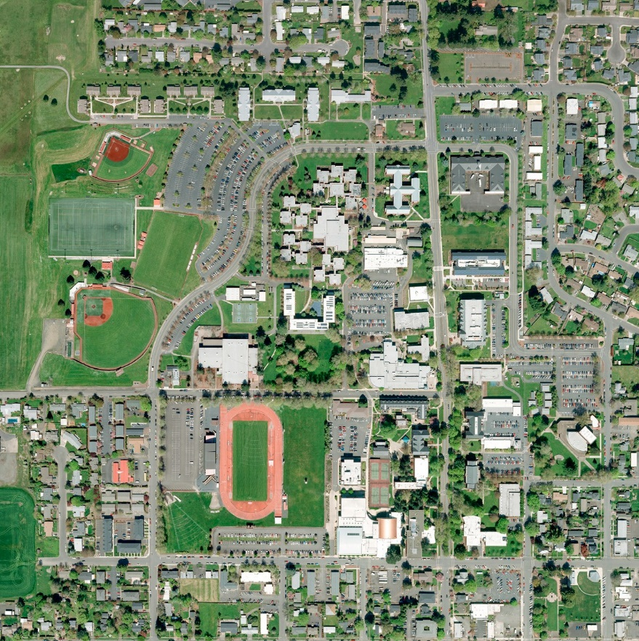
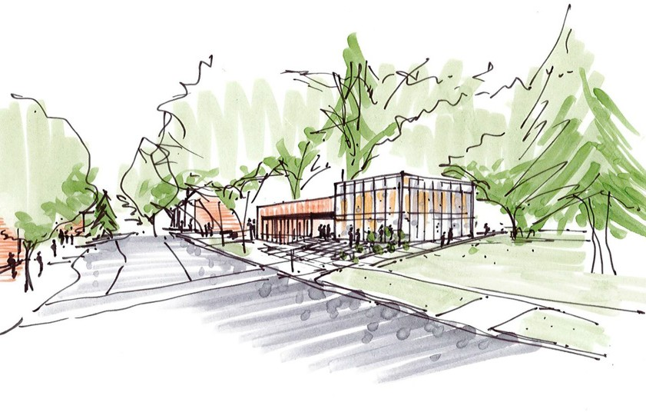
Student Success Center
Student Success Center
Architects Conceptual Drawing
Architects Conceptual Drawing
Total Cost: $21,340,000
Total Cost: $21,340,000
Current Old College of Education building
Current Old College of Education building
31

Slide 32
Student Success Center
Proposed Student Success Center
Conceptual drawings
Architects Conceptual Drawing
Total Cost: $21,340,000
Current Old College of Education building
32

Slide 33
Project Type:
Replacement of Old Education Building with new Student Success Center
Next Steps:
Create a working group representative of the entire WOU Community.
The Working group will help identify occupants and space needs.
Develop a mission statement that defines the purpose of this Center.
Timeline:
Issue RFP to hire an Architect.
Architect will work with WOU on a design. (8 Months)
Issue RFP for Contractors and begin the build process. (12-14 Months)
Open facility – Fall 2023
33

Slide 34
Questions and Comments?
Western Oregon University
Many challenges, yet even more opportunities…

